Slide 1
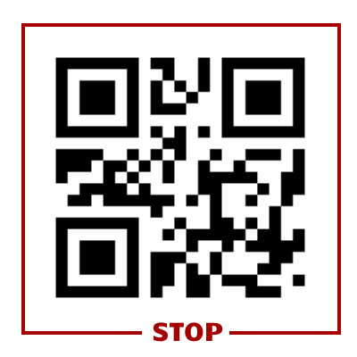
Stop QR code
Should not be placed too close to the edge
Must not be distorted or animated

